Slide 1

DBMS
Group 9
Quiz Web Application
Amit Kumar 20BCS028
Chandravanshi Shubham Arun 20BCS064
Sumit Yadav 20BCS222

Slide 2

Introduction
This is an Online Web Quiz Portal, A platform for conducting online Quiz exam or Practice mock test. This application will help the Teachers to conduct a multiple Quiz or Contest. This application will also help the students to undertake all the available quizzes and particip- ate in them and get the instant result of the quiz.

Slide 3
Purpose
The main objective of thie project is to make eaze to conduct Quiz online and thus push forward the idea of paperless Examination.
Also this application will surely help the students in the preparation of their any kind of exams and help them to achieve their goals.
This application will help the Teachers in creating the question and option and the application will automatically evaluate marks of each student and also in future if there is change in any grading Teacher can easily change the answer of questions and re-evaluate the quiz with just one click.

Slide 4
TECHNOLOGY USED

Slide 5








React JS Node JS HTML CSS
JavaScript Express JS MySQL Xampp

Slide 6
Frontend

Slide 7
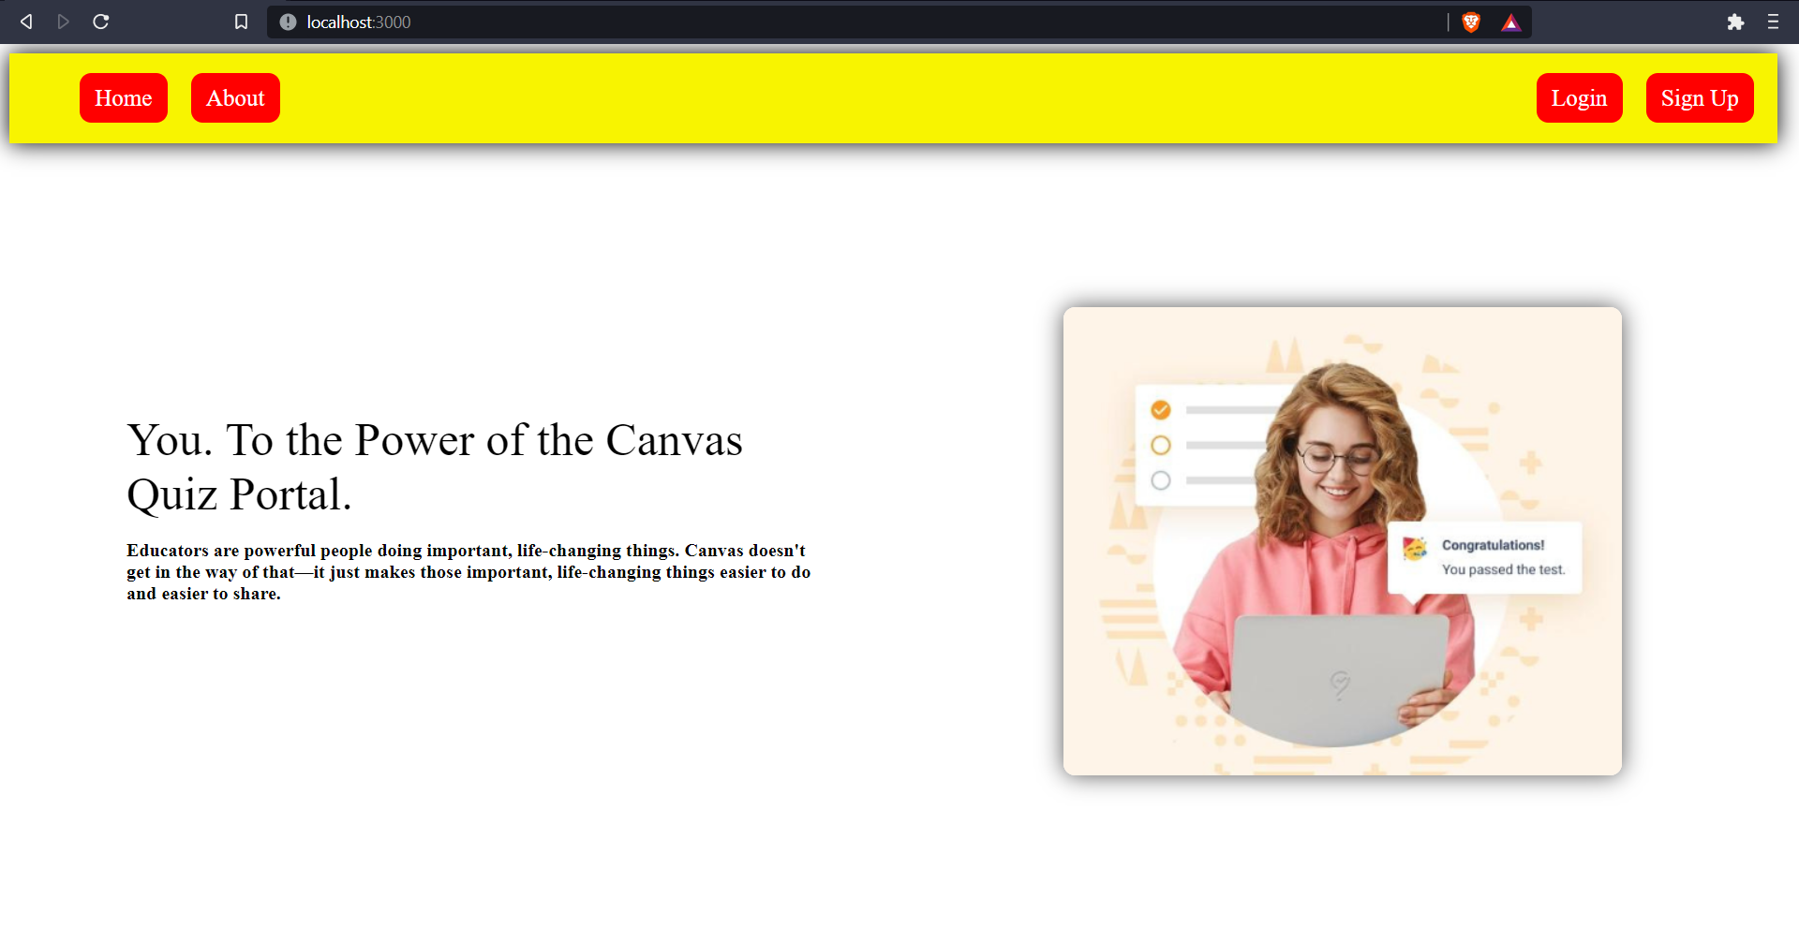
Home Page

Slide 8
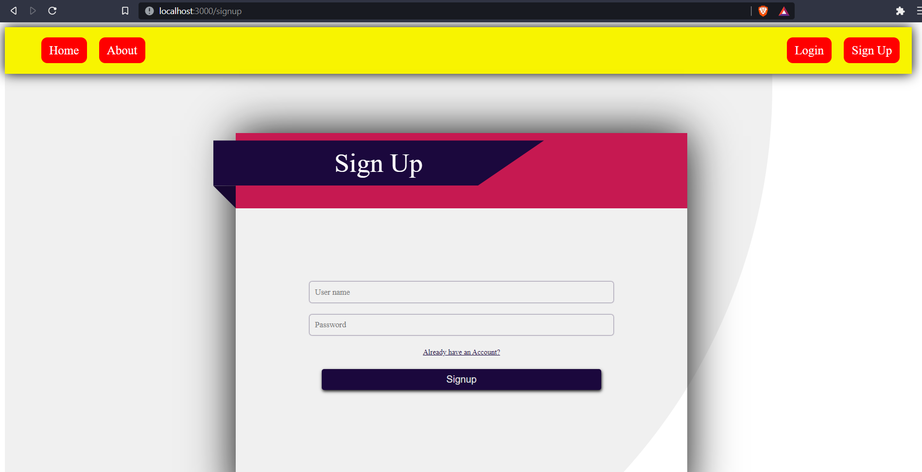
Signup Page

Slide 9
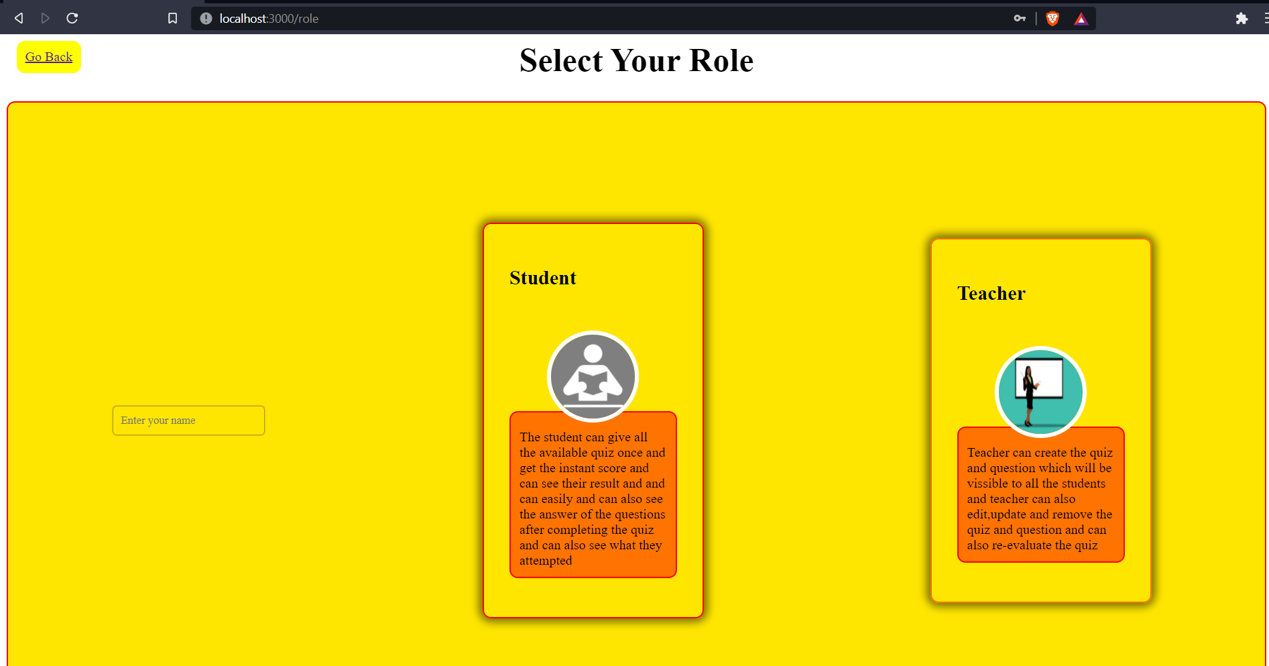
Role Page

Slide 10

Login Page

Slide 11
FOR USER : Teacher

Slide 12
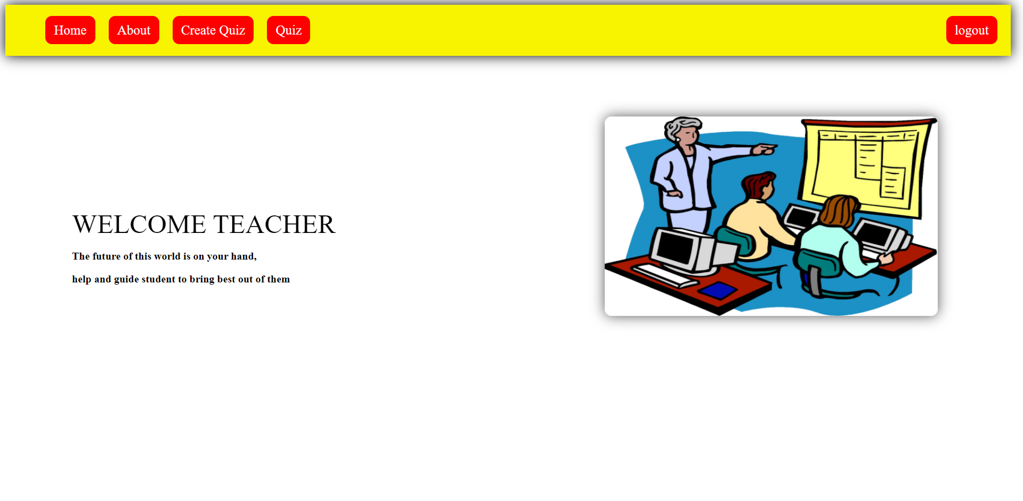
Teacher Home Page

Slide 13
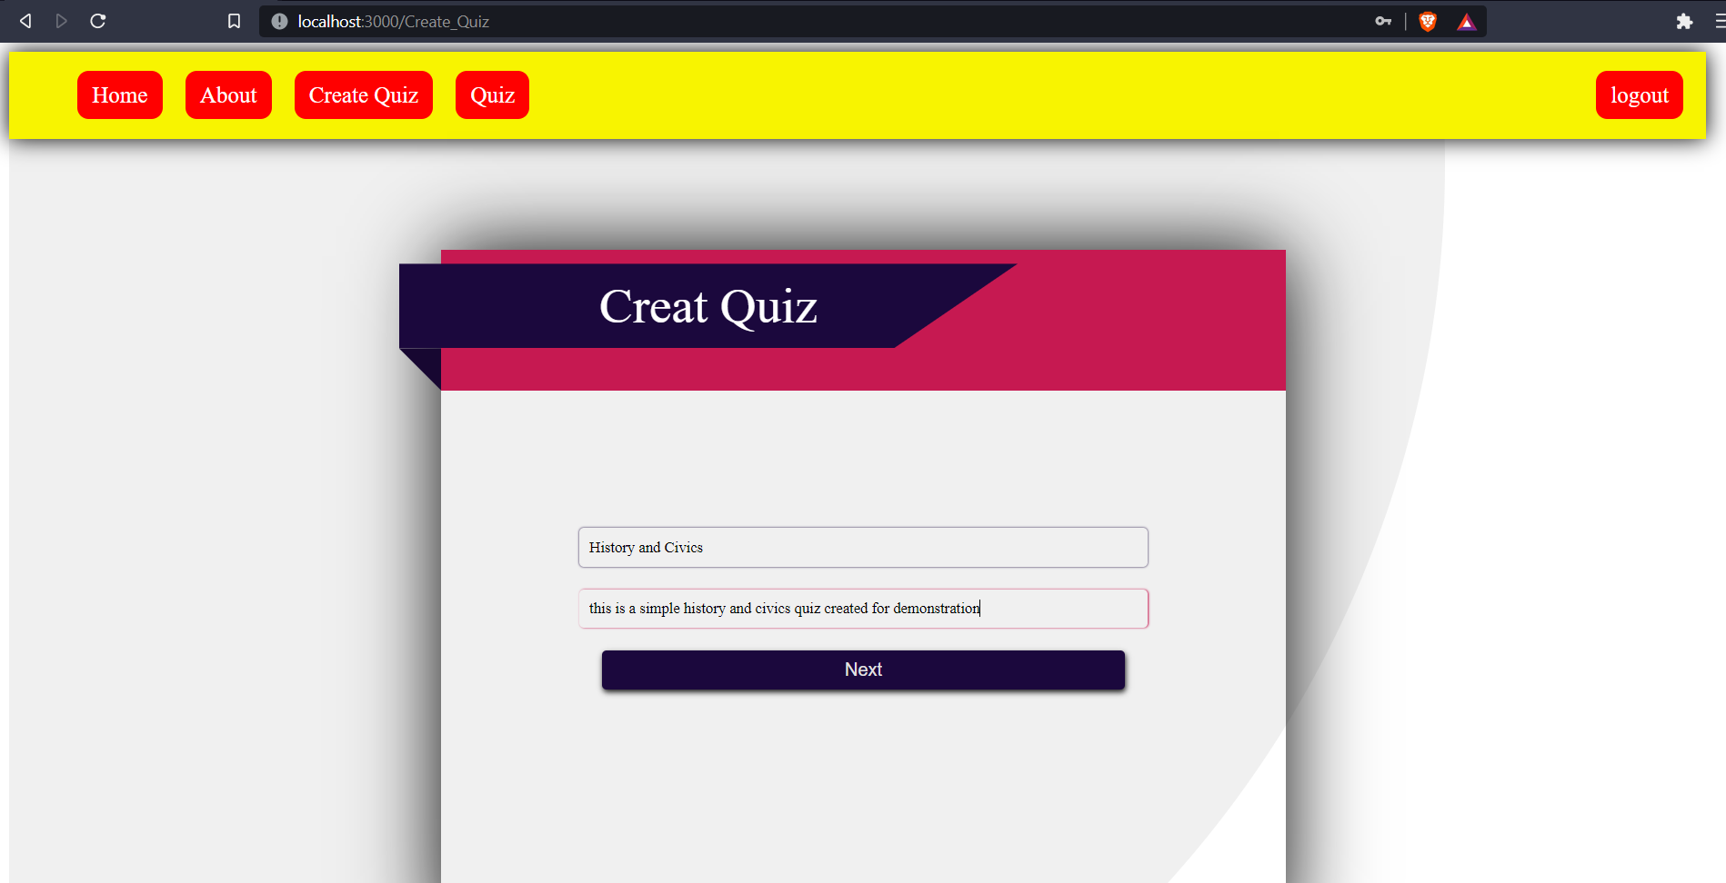
Create Quiz Page

Slide 14
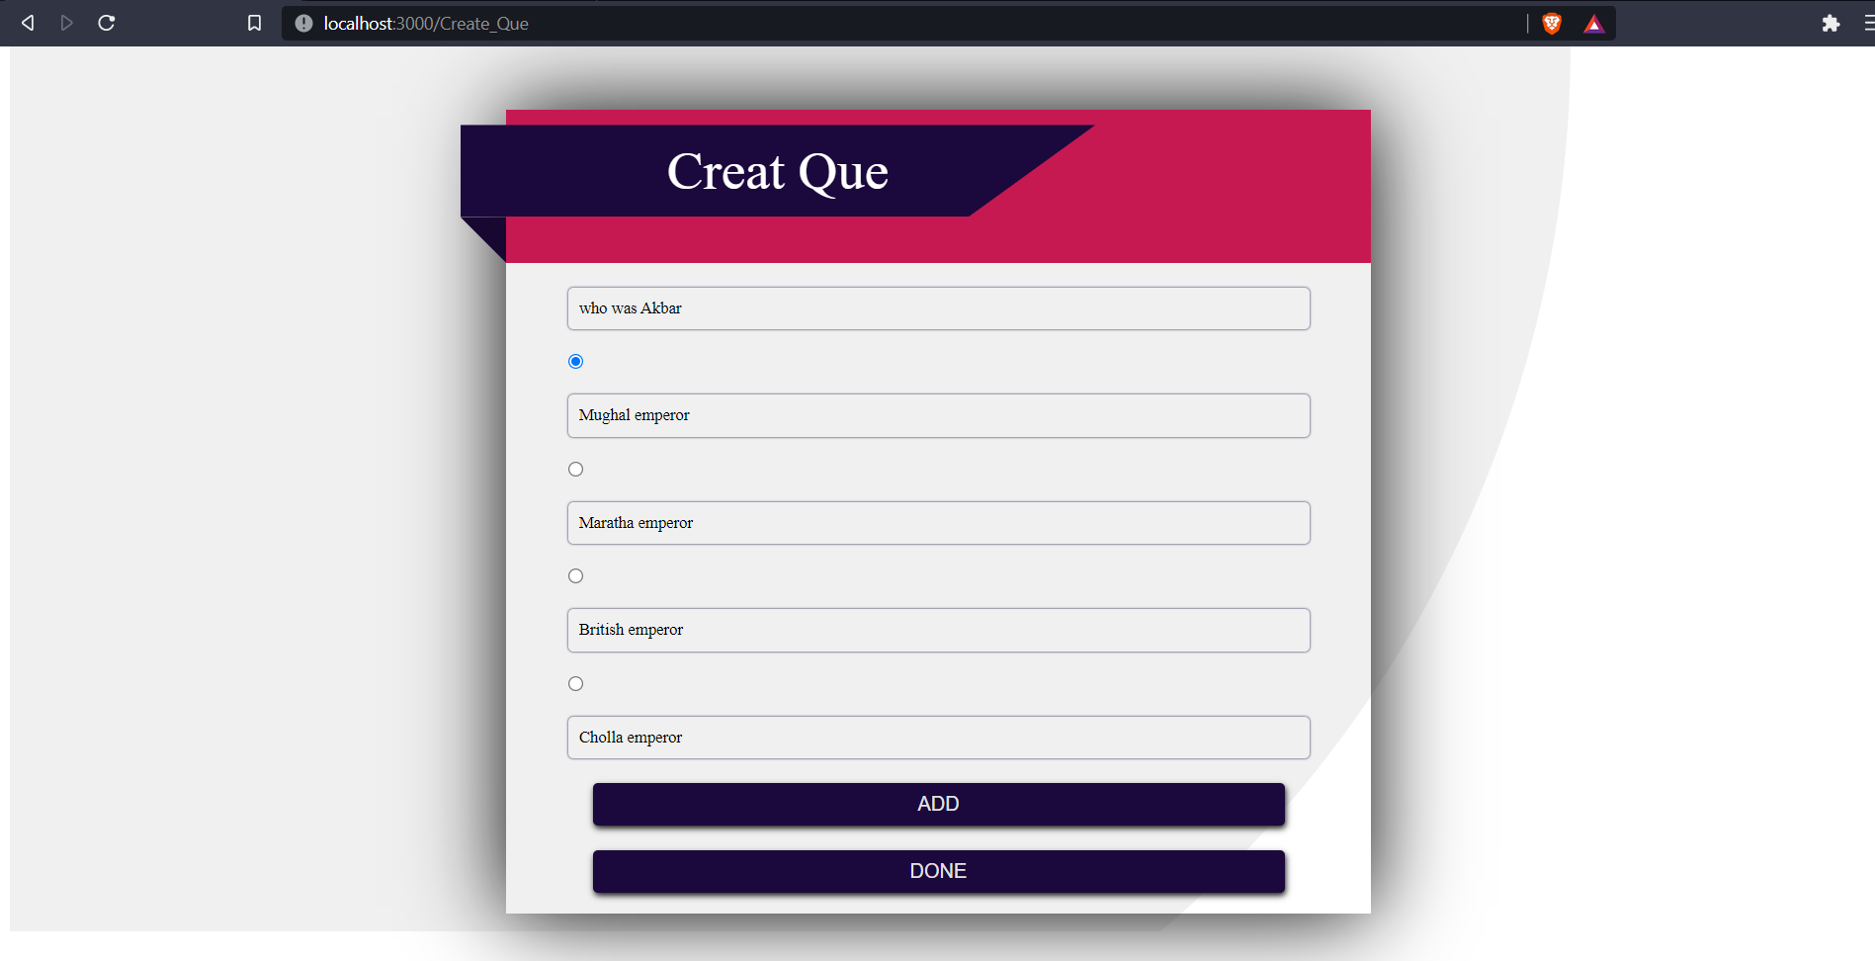
Create Que Page

Slide 15
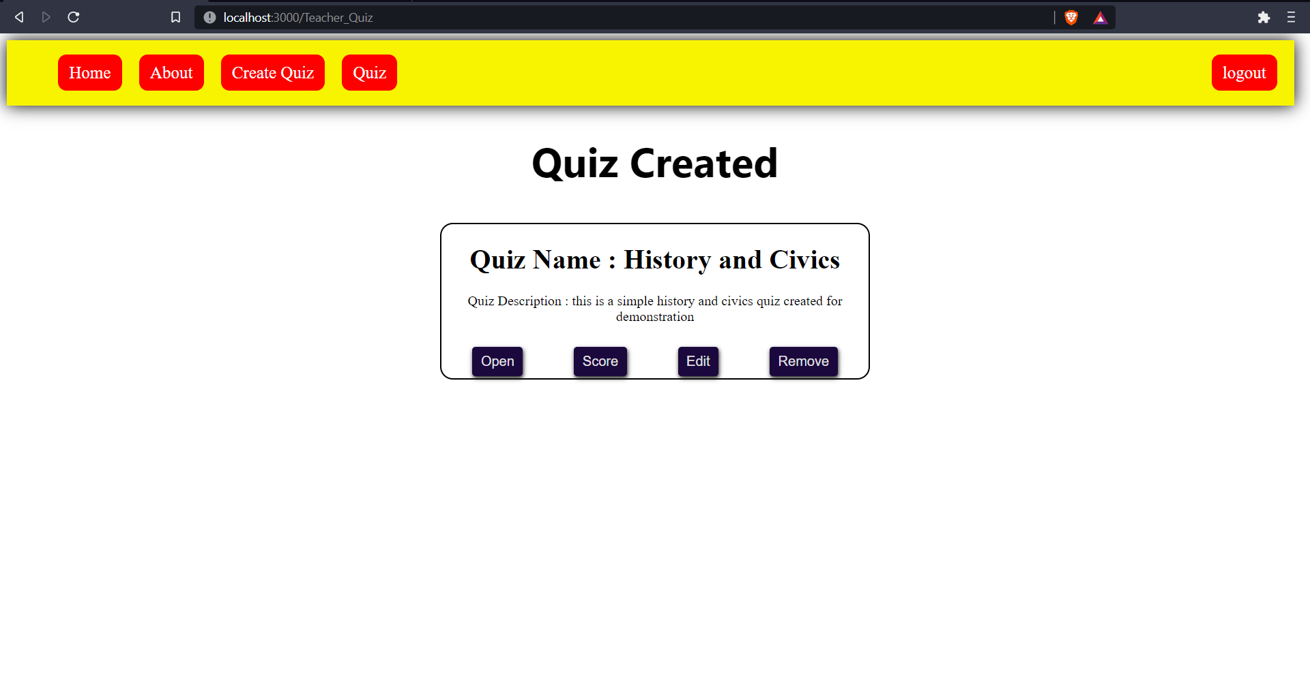
Created Quiz Page

Slide 16
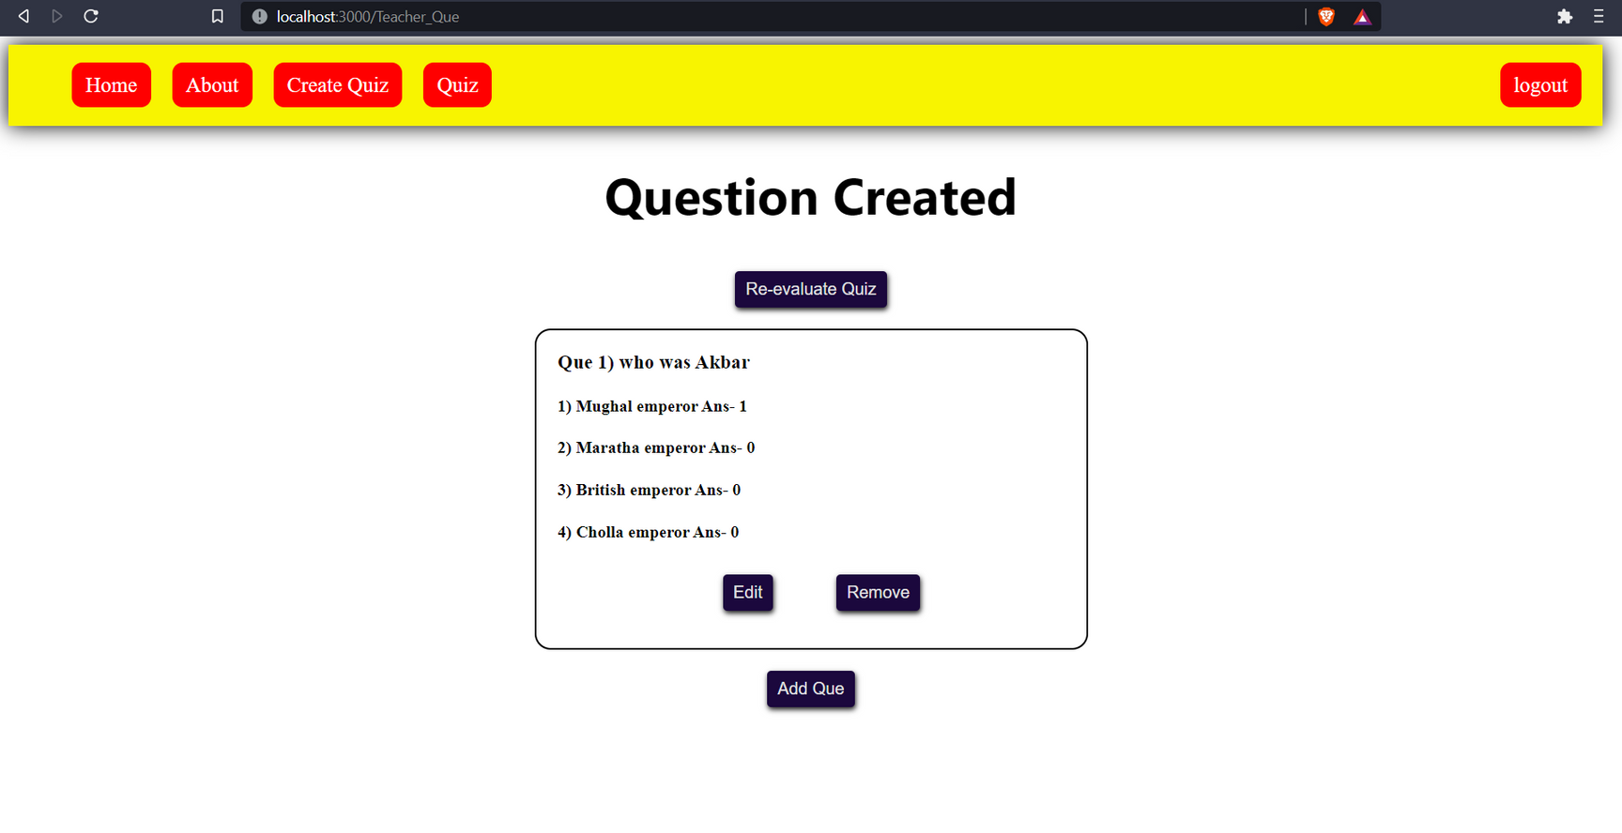
Created Que Page

Slide 17
FOR USER : Student

Slide 18
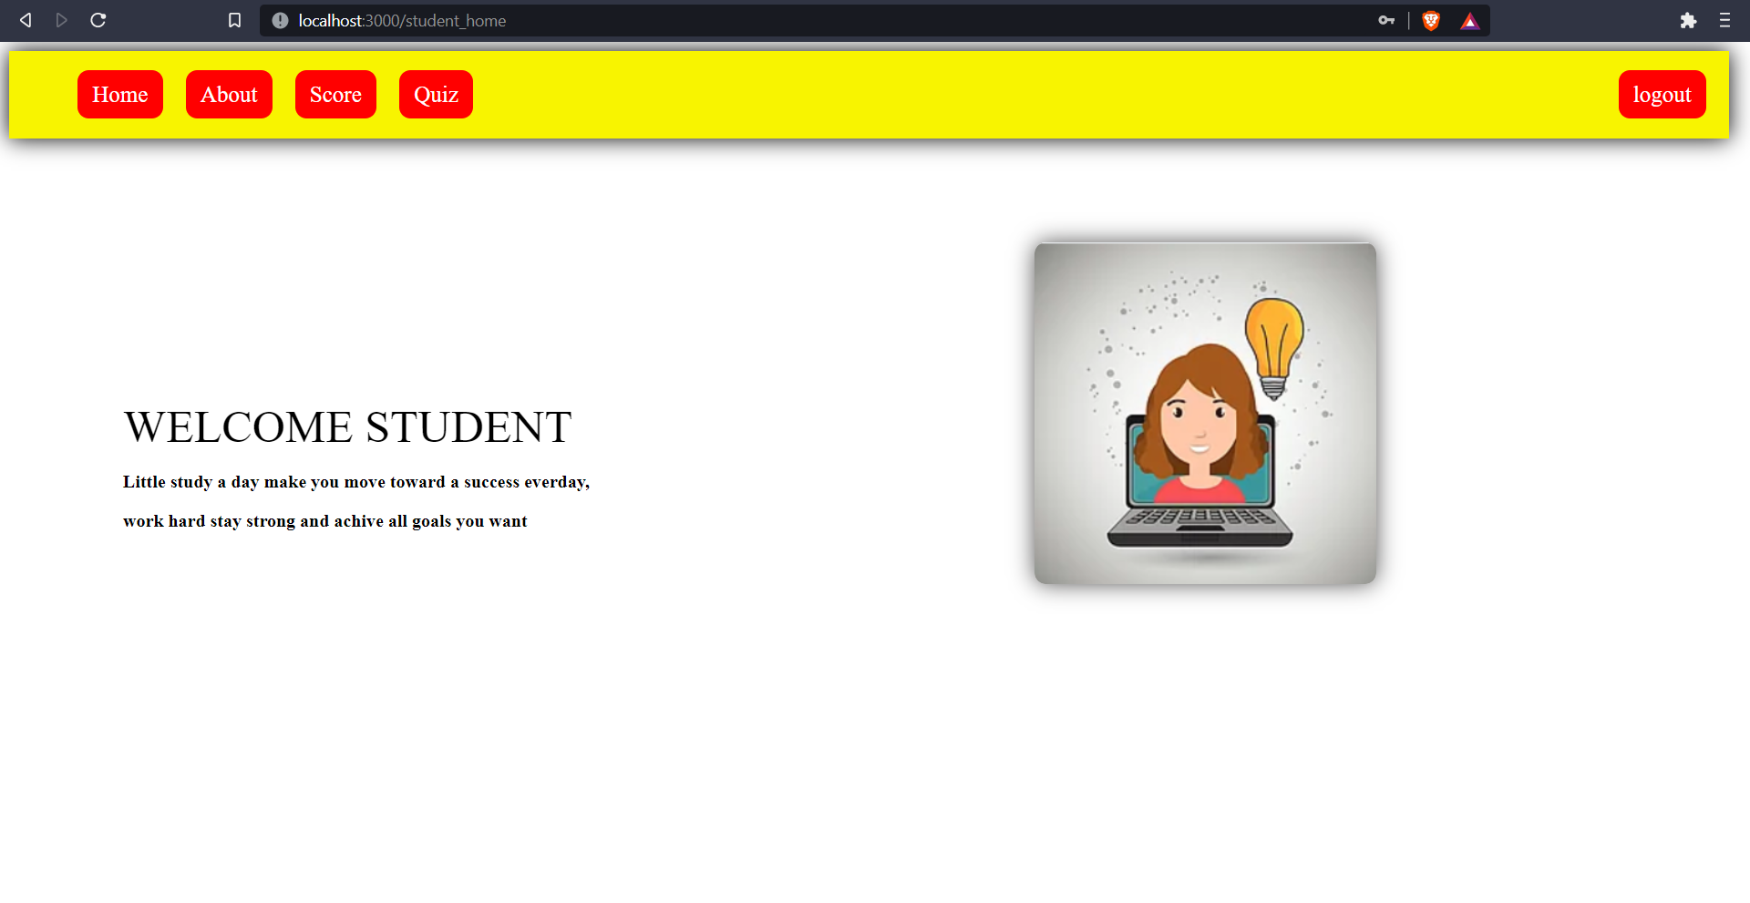
Student Home Page

Slide 19
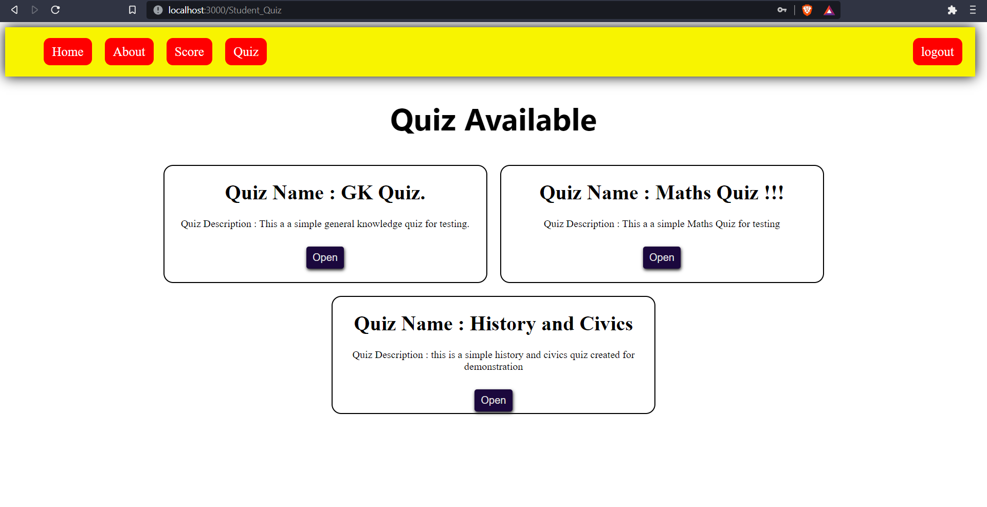
Quiz Available Page

Slide 20
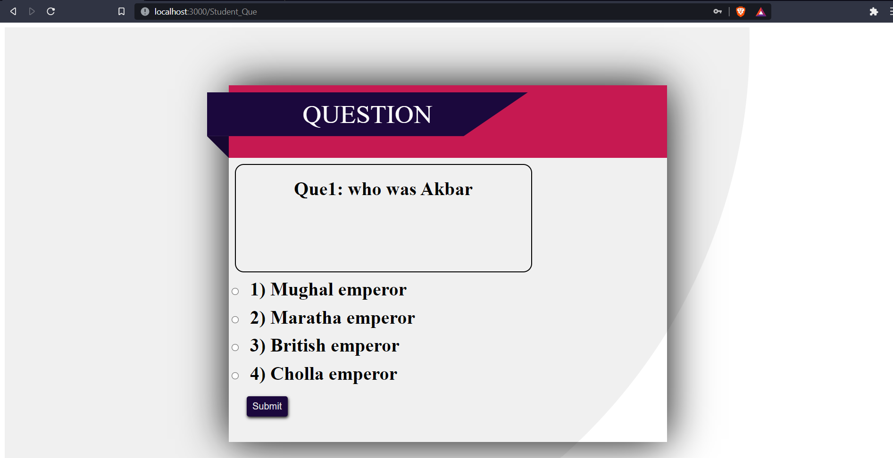
Student Question Page

Slide 21
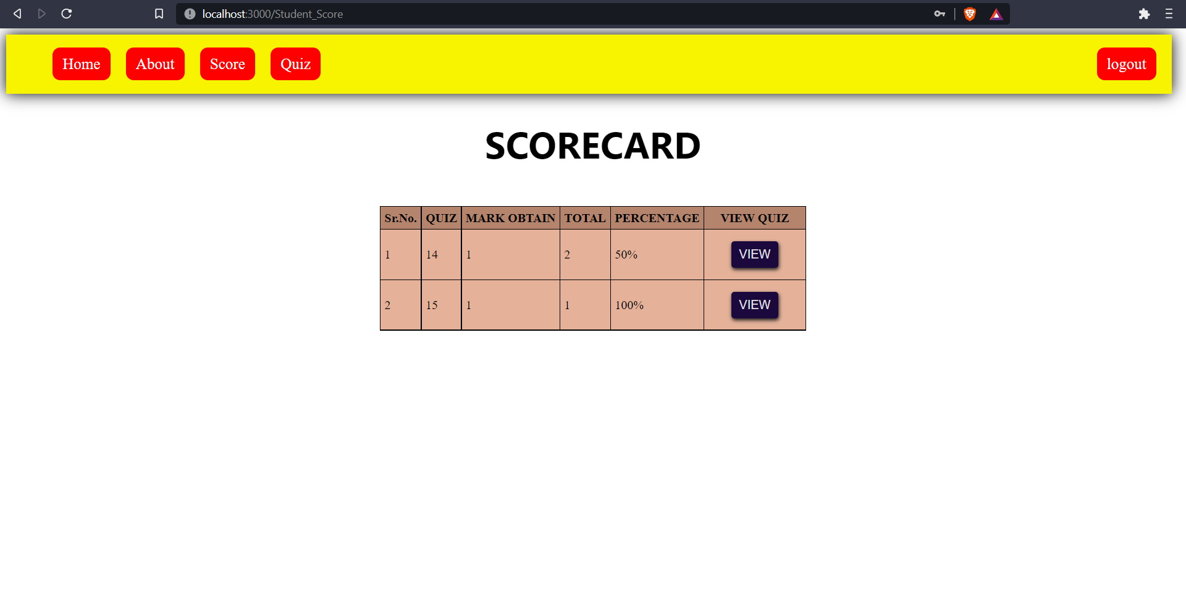
Scorecard Page

Slide 22
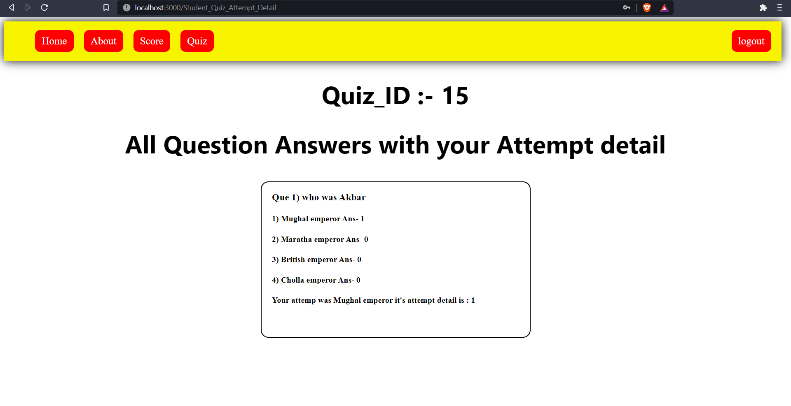
Quiz Attempt Page

Slide 23
FOR USER : Admin

Slide 24
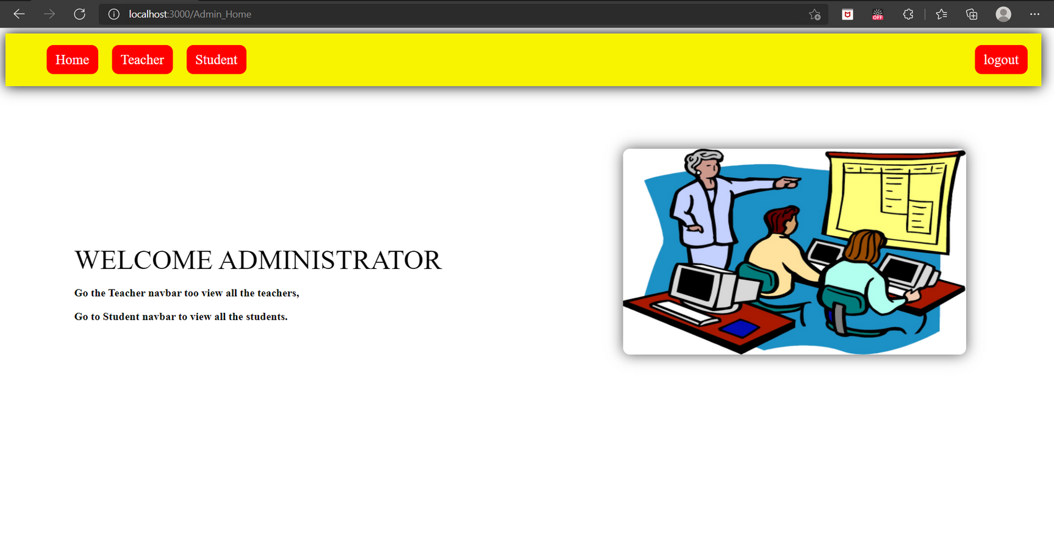
Admin Home Page

Slide 25
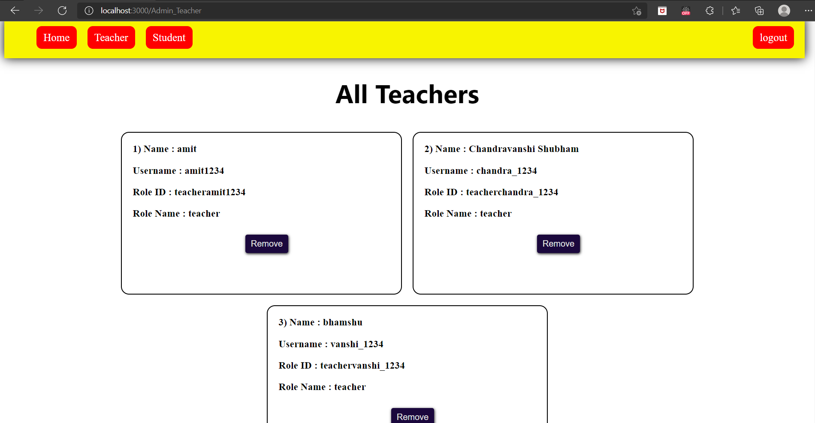
View All Teachers Page

Slide 26
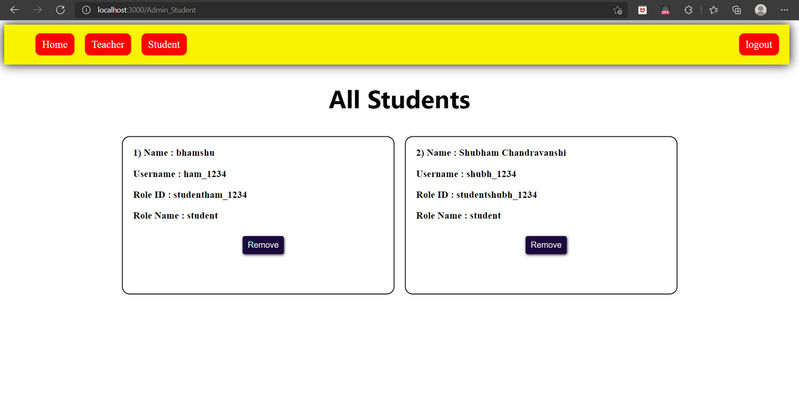
View All Students Page

Slide 27
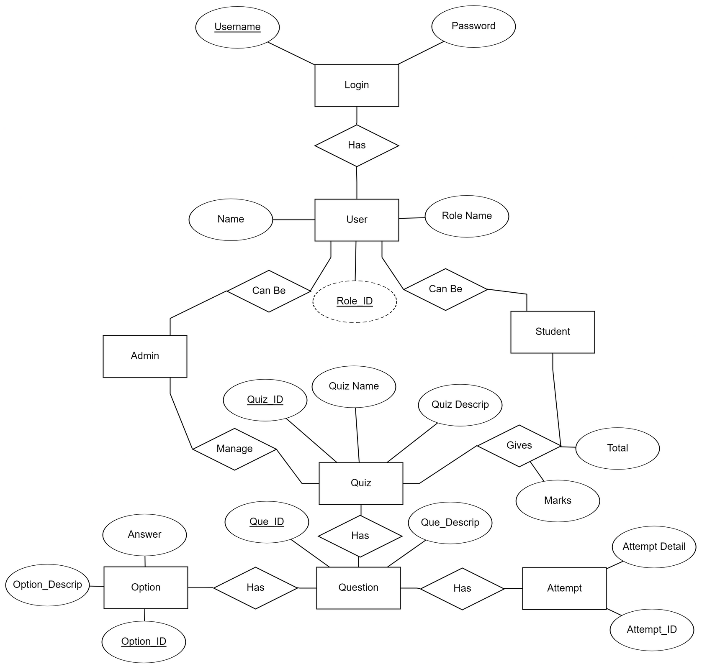
ER-Daigram

Slide 28
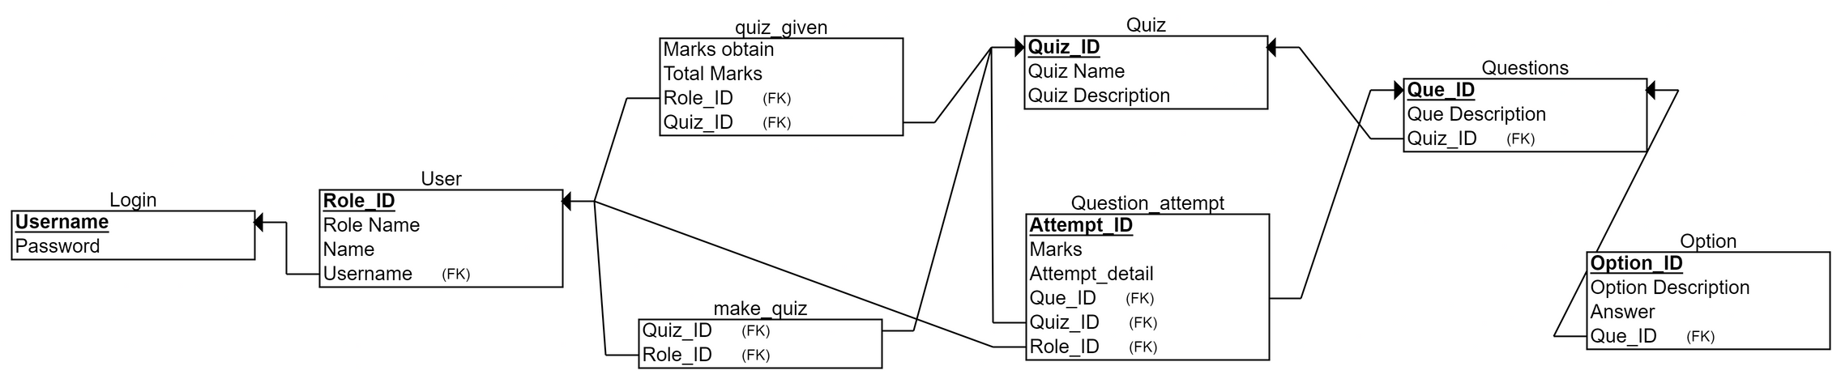
Relational Table

Slide 29


